Slide 1
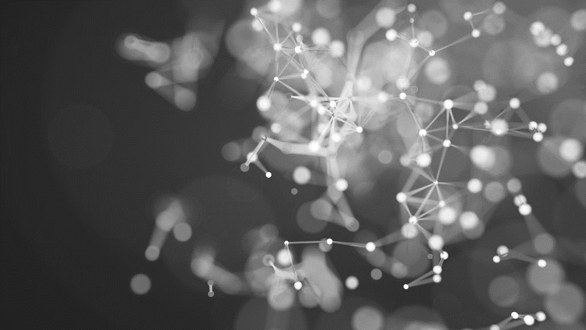
IMPLEMENTING MICROGRAD
A NEURAL NETWORK FROM SCRATCH

Slide 2
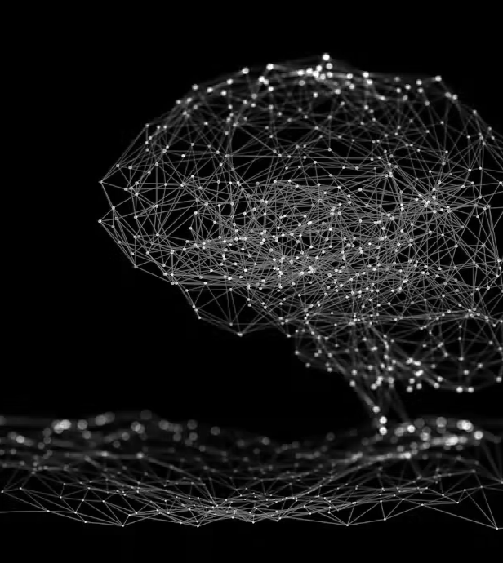
Aim
Implement backpropagation and gradient flow from scratch to construct a simple neural network. This implementation avoids using deep learning libraries, providing an in-depth exploration of the underlying mechanics and mathematical operations involved in neural network training.

Slide 3
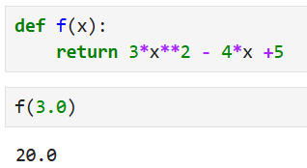
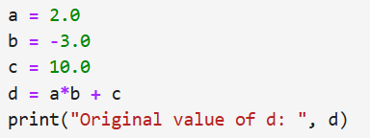
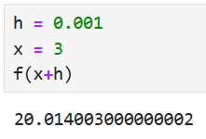
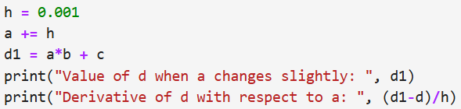
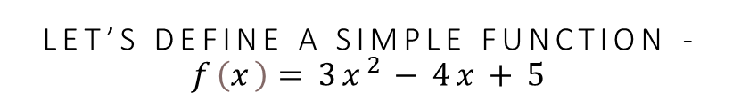
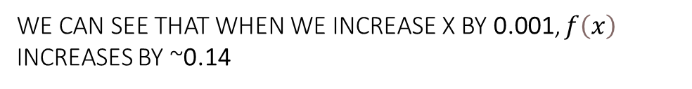
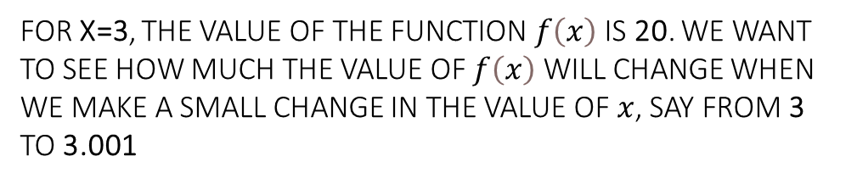
LET’S DEFINE A SIMPLE FUNCTION - $f\left(x\right)=3x^{2}−4x+5$
Understanding derivatives and gradients
NOW LET’S DEFINE A VARIABLE d THAT IS DEPENDENT ON THREE OTHER VARIABLES a, b and c
FOR X=3, THE VALUE OF THE FUNCTION $f\left(x\right)$ IS 20. WE WANT TO SEE HOW MUCH THE VALUE OF $f\left(x\right)$ WILL CHANGE WHEN WE MAKE A SMALL CHANGE IN THE VALUE OF $x$, SAY FROM 3 TO 3.001
LET’S SEE WHAT HAPPENS TO THE VALUE OF d WHEN WE INCREASE THE VALUE OF a BY A SMALL VALUE h
WE CAN SEE THAT WHEN WE INCREASE X BY 0.001, $f\left(x\right)$ INCREASES BY ~0.14
Decreases

Slide 4
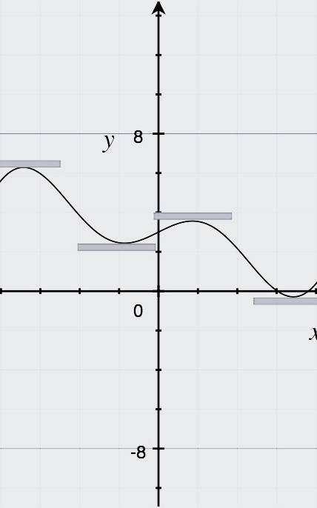
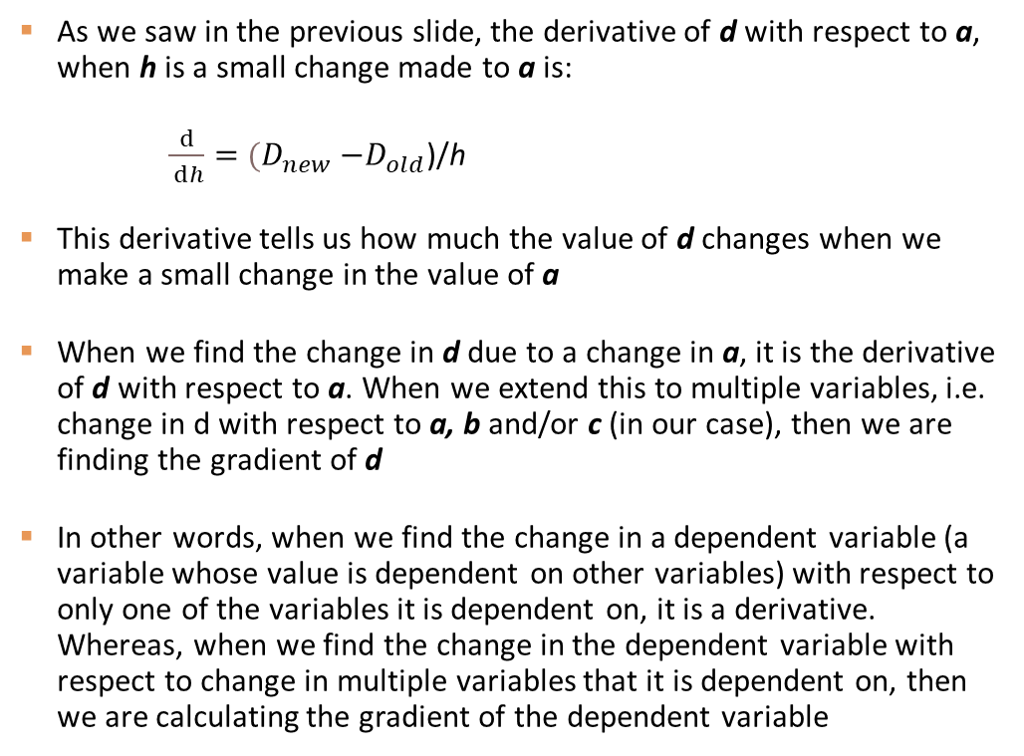
WHAT exactly is a gradient?
As we saw in the previous slide, the derivative of d with respect to a, when h is a small change made to a is:
$\frac{ⅆ}{ ⅆh}=$ ${(D}_{new} −D_{old}$)/h
This derivative tells us how much the value of d changes when we make a small change in the value of a
When we find the change in d due to a change in a, it is the derivative of d with respect to a. When we extend this to multiple variables, i.e. change in d with respect to a, b and/or c (in our case), then we are finding the gradient of d
In other words, when we find the change in a dependent variable (a variable whose value is dependent on other variables) with respect to only one of the variables it is dependent on, it is a derivative. Whereas, when we find the change in the dependent variable with respect to change in multiple variables that it is dependent on, then we are calculating the gradient of the dependent variable

Slide 5
WHY ARE GRADIENTS IMPORTANT IN DEEP LEARNING?
Gradient flow and backpropagation

Slide 6
Backpropagation:
Think of backpropagation as the "teacher" for your deep learning model. Here's how it works:
The model makes a guess (prediction).
The teacher compares the guess to the correct answer and says, "You're this much wrong!" This "wrongness" is called the error.
The teacher then goes back through the model and tells each "decision-maker" (neuron), "Here's how you need to change slightly to improve the next guess."
Backpropagation uses calculus (chain rule) to figure out how much each part of the model contributed to the error and updates those parts accordingly.
Gradient Flow:
This is like the "directions" the model uses to improve.
Imagine you're trying to reach the lowest point of a valley (the best solution).
The gradient tells you which way to step (uphill or downhill) and how big the step should be.
When the gradient flows well, you get clear directions and improve quickly.
If the gradient is too small (vanishing gradient), you're barely stepping, and progress is super slow. If it's too big (exploding gradient), you might take giant, random steps and never reach the goal.

Slide 7
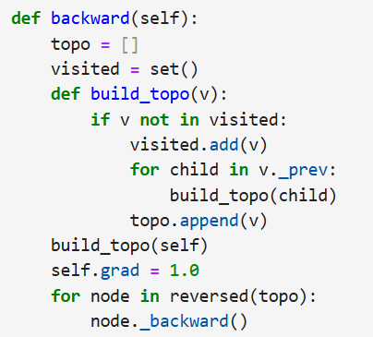
Forward pass:
Let’s assume the following variables – a, b, d, e and f
Let’s define the relation between these variables as:
d= a*b
e = a+b
f= d*e
Set a = -2 and b = 3
Now we can calculate the values of d and e which are -6 and 1 respectively
From d and e we can calculate our output value f = -6
Backward pass:
The backward function defined below calculates the gradient across the neural network during backpropagation. The gradient value of the output variable (f in our case) is set to 1 initially.
For each unvisited neuron in the neural network, we calculate the gradient

Slide 8
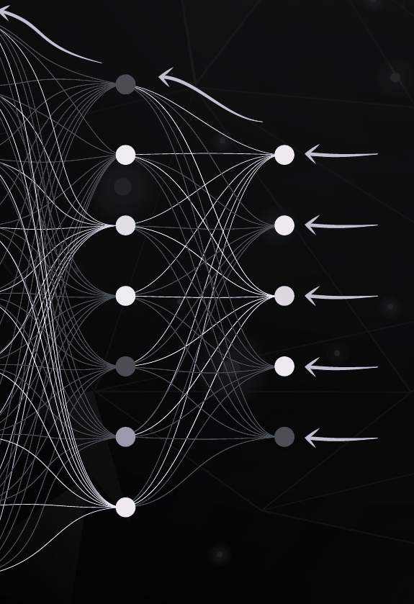

CHAIN RULE IN BACKPROPAGATION
Before we see an example of backpropagation we need to understand the chain rule. To calculate gradients in backpropagation we use the chain rule. Let us take 3 variables x, y, and z. Let x be dependent on y and z be dependent on x. This implies that z is indirectly dependent on y through x. To calculate the derivative of z with respect to x, the chain rule can be applied as –
Put simply, it is the derivative of z with respect to y is multiplied by the derivative of y with respect to x

Slide 9
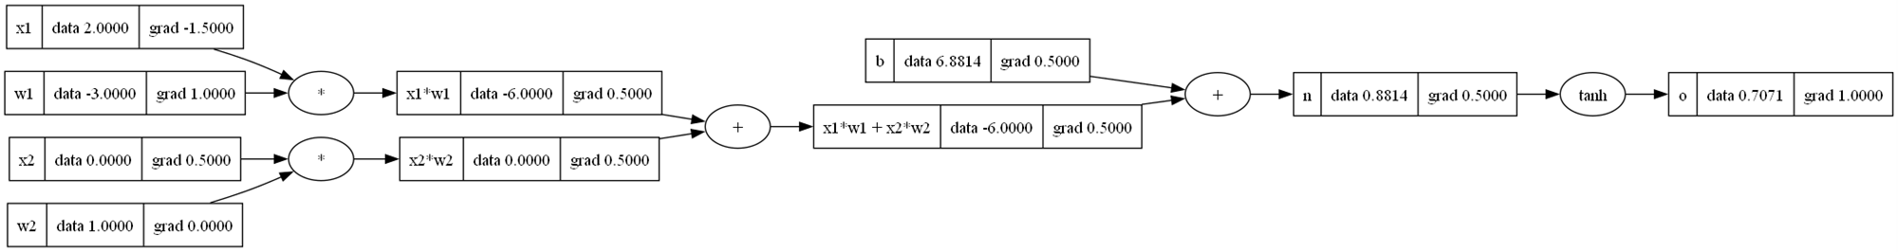
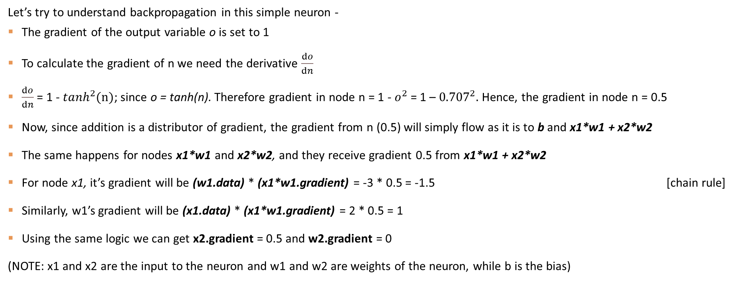
Let’s try to understand backpropagation in this simple neuron -
The gradient of the output variable o is set to 1
To calculate the gradient of n we need the derivative $\frac{ⅆo}{ⅆn}$
$\frac{ⅆo}{ⅆn}$ = 1 - $\tanh^{2}(n)$; since o = tanh(n). Therefore gradient in node n = 1 - $o^{2}$ = 1 – ${0.707}^{2}.$ Hence, the gradient in node n = 0.5
Now, since addition is a distributor of gradient, the gradient from n (0.5) will simply flow as it is to b and x1*w1 + x2*w2
The same happens for nodes x1*w1 and x2*w2, and they receive gradient 0.5 from x1*w1 + x2*w2
For node x1, it’s gradient will be (w1.data) * (x1*w1.gradient) = -3 * 0.5 = -1.5 [chain rule]
Similarly, w1’s gradient will be (x1.data) * (x1*w1.gradient) = 2 * 0.5 = 1
Using the same logic we can get x2.gradient = 0.5 and w2.gradient = 0
(NOTE: x1 and x2 are the input to the neuron and w1 and w2 are weights of the neuron, while b is the bias)

Slide 10
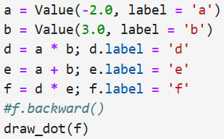
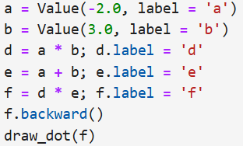
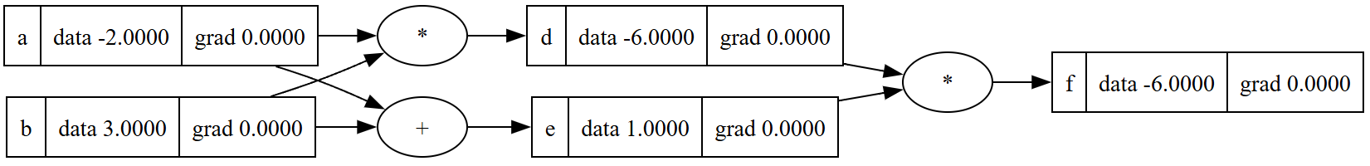
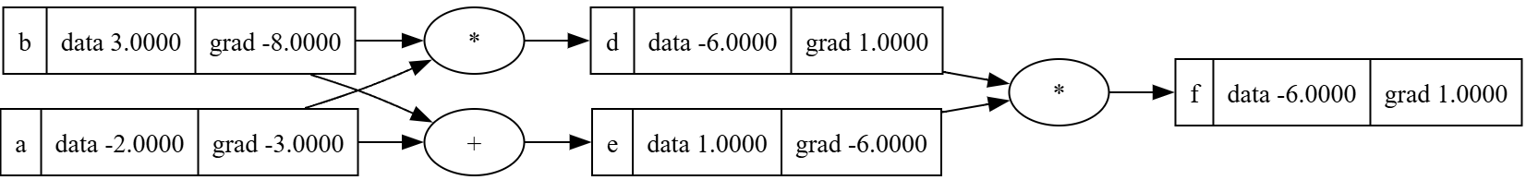

Example of forward and backward propagation In neural networks
Forward
Backward
Backward function (which calculates gradients is commented out)

Slide 11
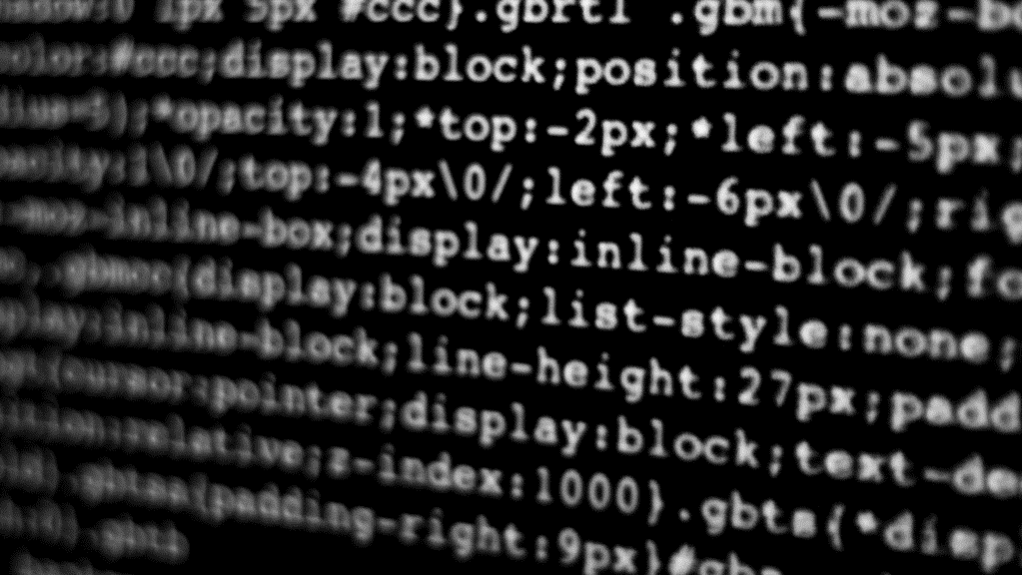
MULTI-LAYER PERCEPTRON (MLP)

Slide 12
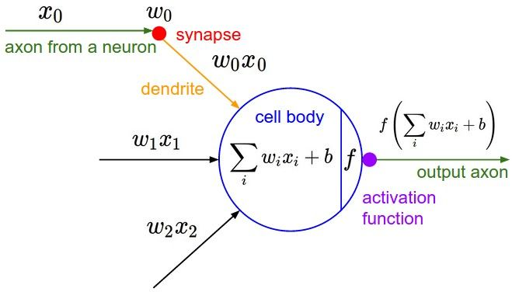
BUILDING A NEURON
We have inputs x’s which interact with a weight in the synapse w’s multiplicatively.
These multiplied terms (x.w) are given as input to the cell body
All x.w are summed in the cell body and a bias b is added to them
We pass this output from the cell body through an activation function for example tanh

Slide 13
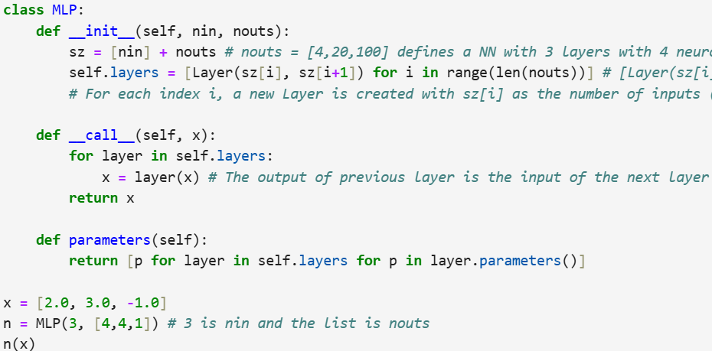
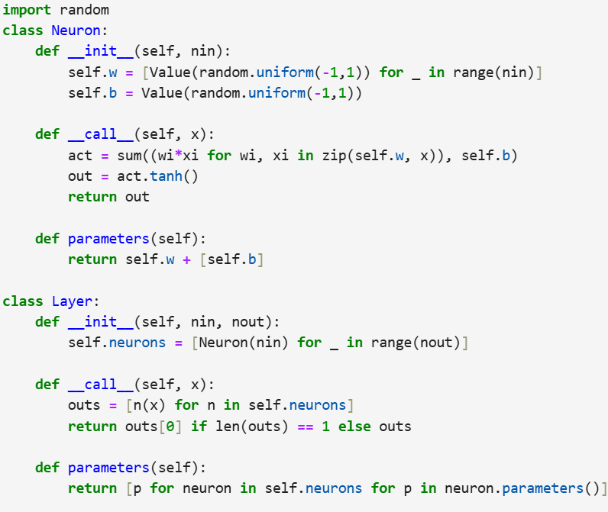
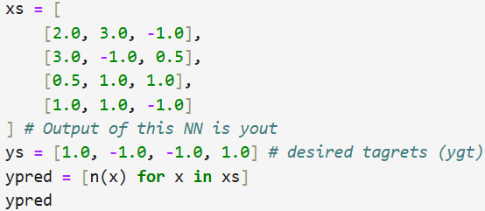
Code for building mlp

Slide 14
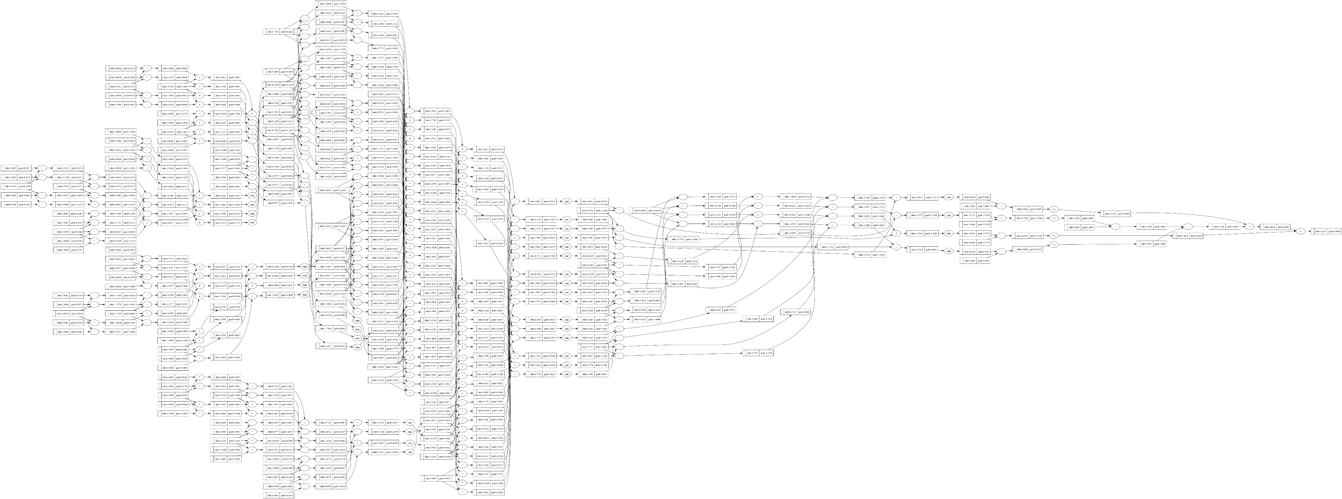
FORWARD AND BACKWARD PROPAGATION IN OUR MLP

Slide 15
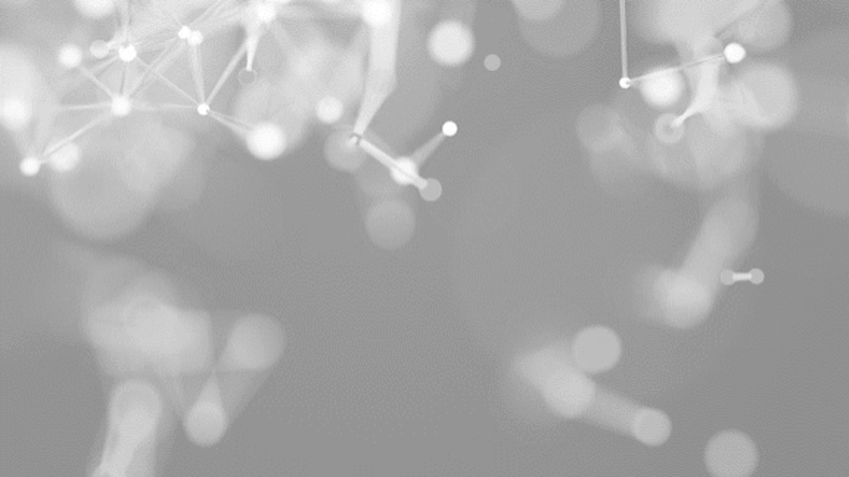
THANK YOU
Yajur Khanna
yajur.khanna910@gmail.com

